Slide 1
Neural Networks and Learning

Slide 2
Outline
Perceptrons
Gradient descent
Multi-layer networks
Backpropagation

Slide 3

Learning Agent

Slide 4
Neural Networks in action
Applications are numerous, here’s one from the Postal Office:
Data Analytics Key to U.S. Postal Service Digital Transformation – OpenGov Asia

Slide 5
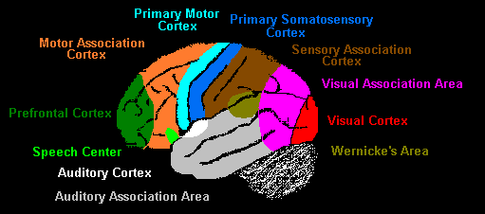
Sensory Areas of the Human Brain

Slide 6
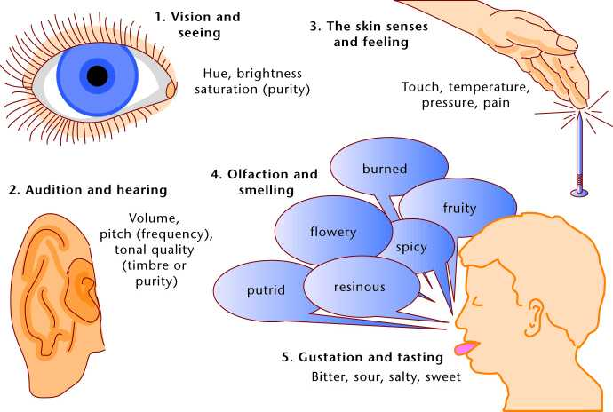
Brain performs classifications, predictions and associations

Slide 7
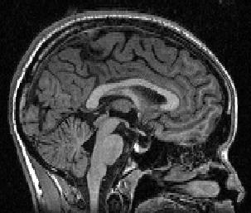
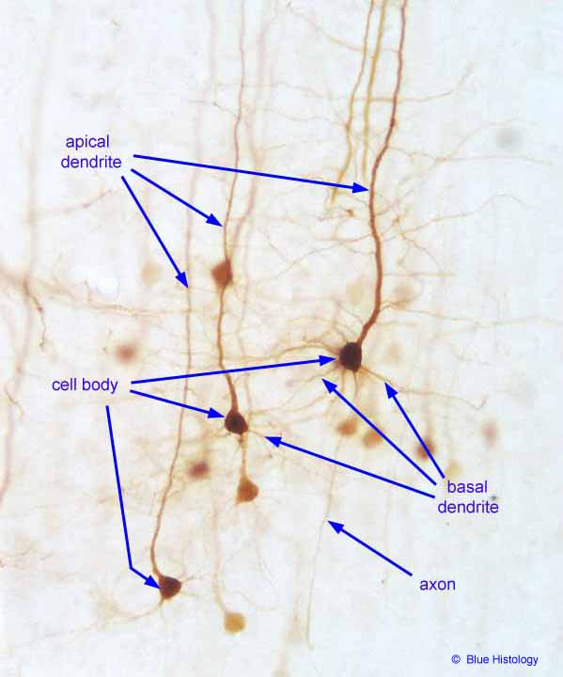
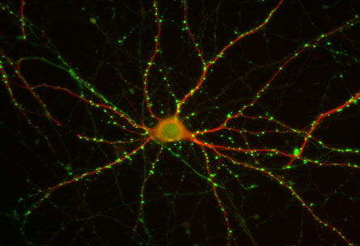
Neural Networks
Huge connectivity: each neuron sends and receives 10⁴ of synapses (contacts)
Huge complexity
10¹¹ of neurons in the brain

Slide 8
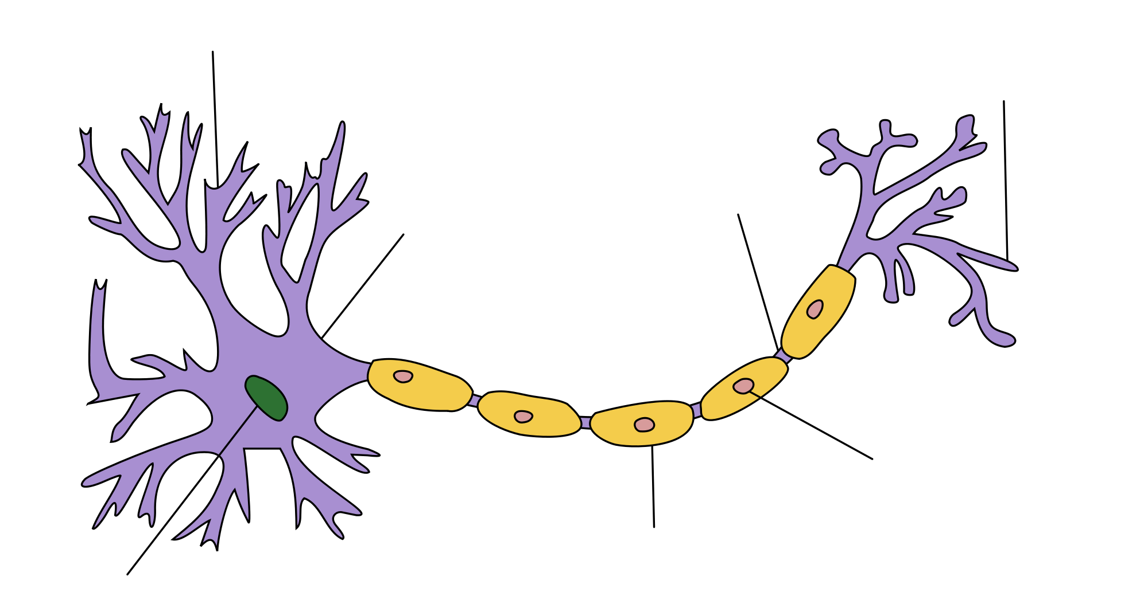
Neuron Interconnectivity

Slide 9
Graphical Notation & Terms
Circles
  Are neural units
  Metaphor for nerve cell body
Arrows
  Represent synaptic connections from one unit to another
  These are called weights and represented with a scalar numeric value (e.g., a real number)
Layer of neural units
Input layer

Slide 10
Another Example: 8 units in each layer, fully connected network

Slide 11
Properties of
Artificial Neural Nets (ANNs)
Many simple neuron-like threshold switching units
Many weighted interconnections among units
Highly parallel, distributed processing
Learning by tuning the connection weights
ANN are motivated by biological neural systems
But not as complex as biological systems

Slide 12
Appropriate Problem Domains for Neural Network Learning
Input is high-dimensional discrete or real-valued
Output is discrete or real valued
Output is a vector of values
Form of target function is unknown
Used in cases where humans do not need to interpret the results (black box model)
Training examples may contain errors (ANNs are robust to errors)

Slide 13
Units & Weights
1
W_{1,1}
Units
  Sometimes notated with unit numbers
Weights
  Always represent numbers
  May be integer or real valued
2
W_{1,2}
1
3
W_{1,3}
Unit number
Unit numbers
W_{1,4}
4
1
0.3
2
-0.1
1
2.1
3
-1.1
4

Slide 14
Perceptron
Linear threshold unit (LTU)
x₁
w₁
w₂
x₂
Σ
o
.
.
.
Σ_{i=1,..., n} w_{i} x_{i}
w_{n}
x_{n}
1 if Σ_{i=1,...,n} w_{i} x_{i} >0
o(x_{i})=
-1 otherwise
{

Slide 15
Processing at a Node
weight 1
Activation Function
Output
weight 2
1.0
Sum
0.5
weight 3
Sum
weight 4

Slide 16
Computing with Neural Units
Inputs are presented to input units
How do we generate outputs?
One idea
  Summed Weighted Inputs
Input: (3, 1, 0, -2)
Processing:
3(0.3) + 1(-0.1) + 0(2.1) + -1.1(-2)
= 0.9 + (-0.1) + 2.2
Output: 3
1
0.3
2
-0.1
2.1
3
-1.1
4

Slide 17
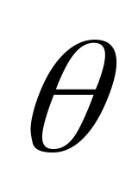
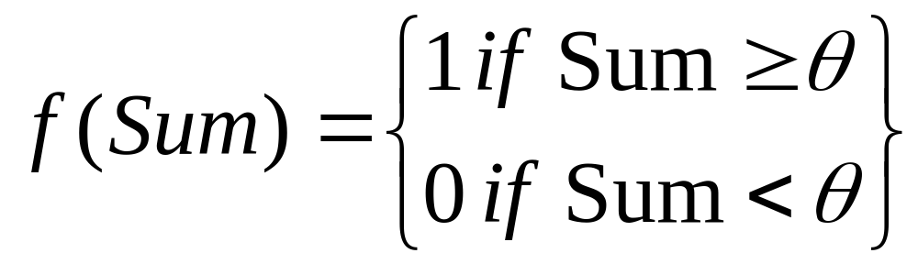
Activation Functions
Usually, don’t just use weighted sum directly
Apply some function to the weighted sum before it is used (e.g., as output)
Call this the activation function
Step function could be a good simulation of a biological neuron spiking
Is called the threshold
f is the Step function

Slide 18

Step Function Example
Let Θ = 3
Input: (3, 1, 0, -2)
1
0.3
1
2
-0.1
x=3
2.1
3
3
-1.1
4
Output after passing through step activation function:

Slide 19

Step Function Example (2)
Let Θ = 3
Input: (0, 10, 0, 0)
1
0.3
1
2
-0.1
x
2.1
3
3
-1.1
4
Output after passing through step activation function:
Notes:
X = -1

Slide 20
Step Function: Pros and Cons
Simple and computationally very efficient to compute
Major limitation is its discontinuity at point 0 – this makes it unsuitable for use with gradient descent
Gradient descent is a very efficient method at computing weights and requires functions to be continuous in nature

Slide 21
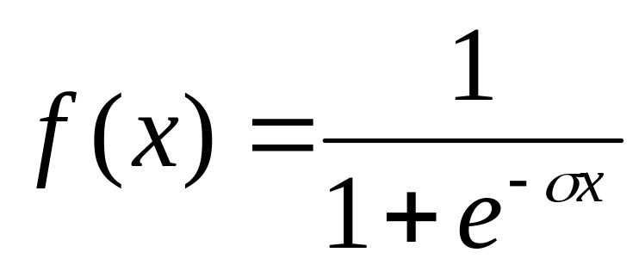

Another Activation Function:
The Sigmoidal
The math of some neural nets requires that the activation function be continuously differentiable
A sigmoidal function often used to approximate the step function
Is the steepness parameter

Slide 22
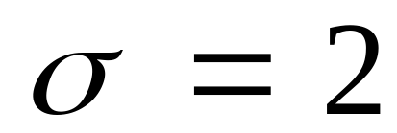
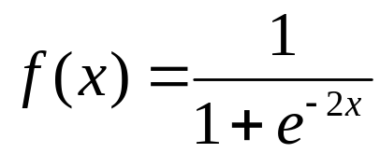
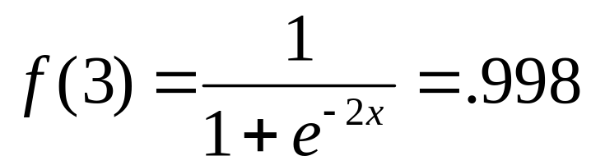
Sigmoidal Example
Input: (3, 1, 0, -2)
0.3
-0.1
2.1
-1.1
Input: (0, 10, 0, 0)
network output?
Notes:
Second example = .16

Slide 23
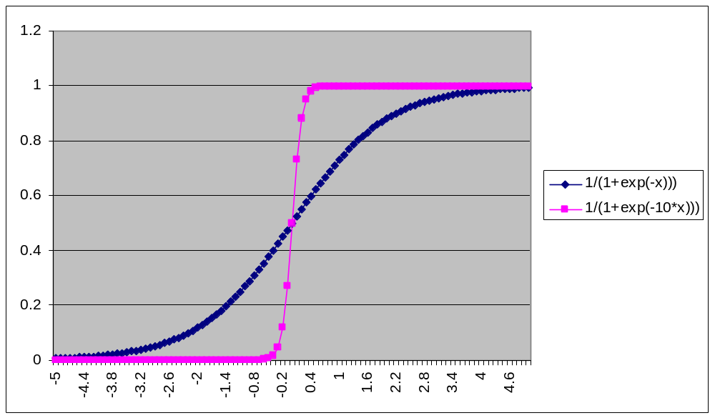
Sigmoidal

Slide 24
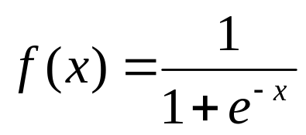
Another Example
A feedforward network
Two inputs, one output
Input: (3, 1)
0.5
-0.5
What is the output?

Slide 25
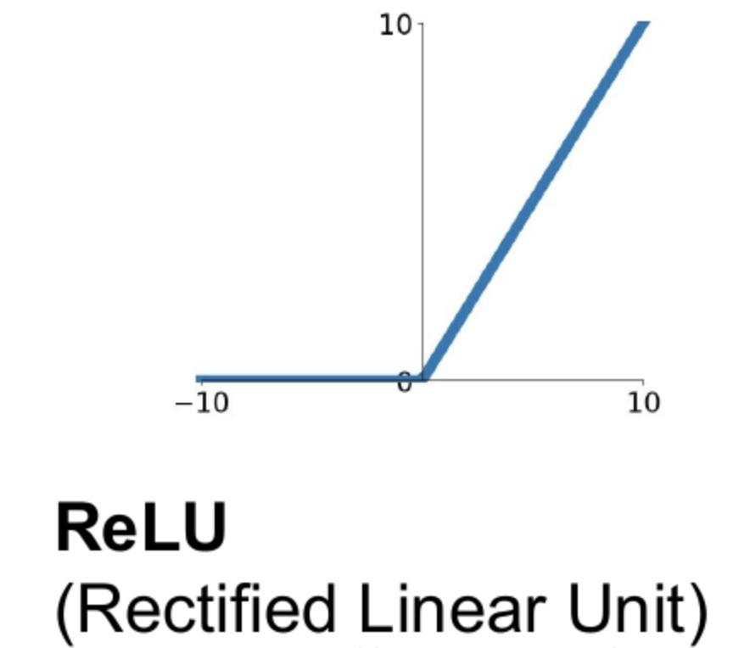
Relu Activation
The Rectified Linear Unit function is now commonly used in the hidden layers in ANNs
The Sigmoid is commonly used in the output layer as a thresholding function
Relu(x) = Max(0,x) for all x
This Photo by Unknown Author is licensed under CC BY-SA

Slide 26
Relu
Relu has two attractive properties when compared to the Sigmoid
  It is cheap to compute
  It does not have the vanishing gradient problem that the Sigmoid is vulnerable to (more on this later)

Slide 27
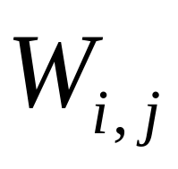
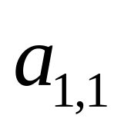
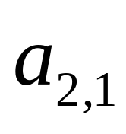
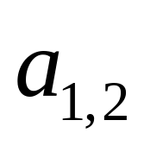
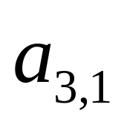
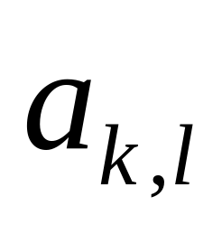
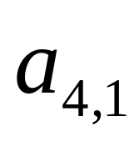
Notation
At times useful to represent weights and activations using vector and matrix notations
Weight (scalar) from unit j in left layer to unit i in right layer
W_{1,1}
W_{1,2}
W_{1,3}
Activation value of unit k in layer l; layers increase in number from left to right
W_{1,4}

Slide 28
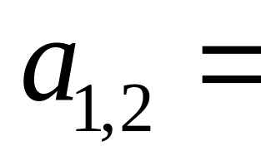
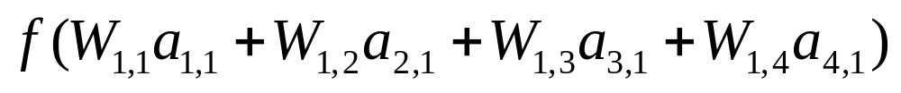
Notation for Weighted Sums
W_{1,1}
W_{1,2}
W_{1,3}
W_{1,4}

Slide 29
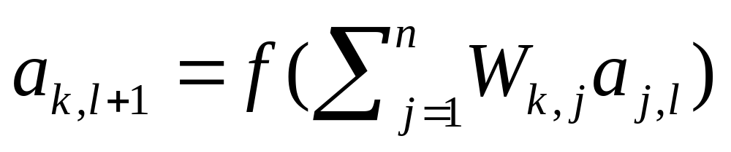
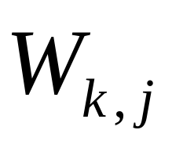
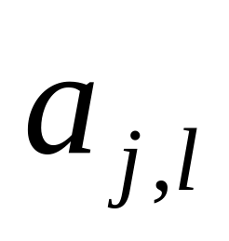
Generalizing
Weight (scalar) from unit j in left layer to unit k in right layer
W_{1,1}
W_{1,2}
W_{1,3}
W_{1,4}
Activation value of unit j in layer l; layers increase in number from left to right

Slide 30
Use Case 1:Function Approximation
ANNs can learn any complex function given sufficient data
In practice though we want to keep to keep the function as simple as possible in order to avoid overfitting
Input units (X): Function inputs (vector)
Output unit (Y): Function output – single value
If we think of fitting an order n polynomial, then n neurons will suffice – generally we want to keep n small say at 2 or 3 to avoid overfitting.

Slide 31
Use Case 2: Classification
Here the number of output neurons is equal to the number of classes
The key question here is: How to set the number of output neurons?
Method 1:
  use a rule of thumb such as the average of the number of input and output neurons
  using the average as a starting point, search for the optimal number by minimizing error on validation data

Slide 32
Use Case 2: Classification
In practice, classifiers are rarely built on their own
Other classifier types such as a Decision Tree classifier is generated to compare with
We can take advantage of this by noting the number of leaf nodes (L) in a well tuned decision tree model

Slide 33
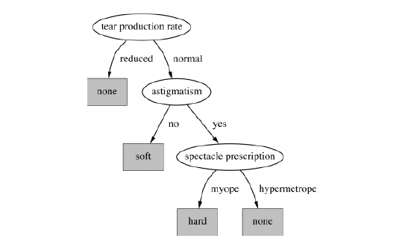
Use Case 2: Classification
L indicates the number of patterns in the data which in turn indicates the number of hidden neurons
Thus L can be used to tune the ANN

Slide 34
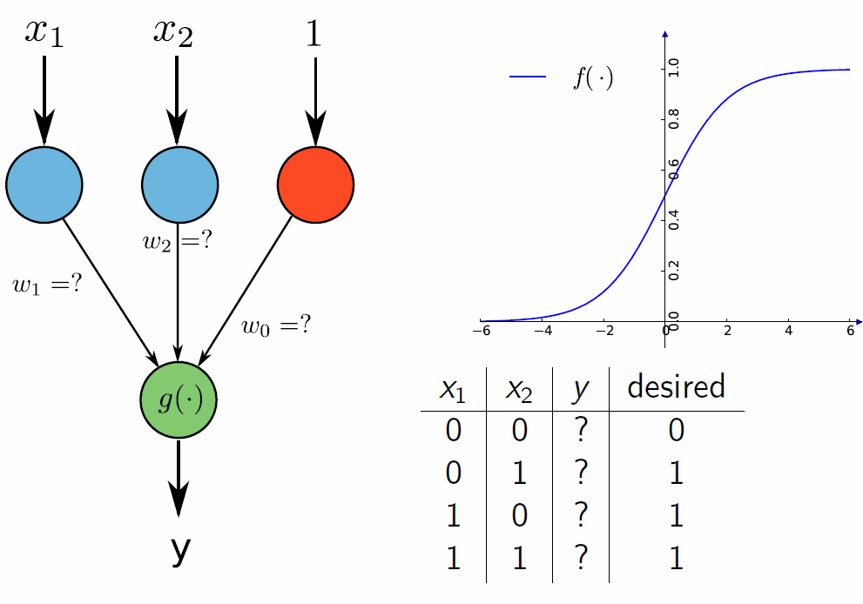
Example 1: Solving the Logical OR Problem
In this case there is only one pattern and so a single hidden neuron (activated by Relu) will suffice
The hidden neuron can also double as an output neuron with thresholding by the Sigmoid

Slide 35
Example 2: XOR
In this case there are two patterns and hence 2 hidden neurons are needed
x1
y1
No. | x1 | x2 | z1
1 | 0 | 0 | 1
2 | 0 | 1 | 0
3 | 1 | 0 | 0
4 | 1 | 1 | 1
z1
x2
y2
What weights (and threshold values applied at y1 and y2) would allow this architecture to capture this operation?

Slide 36
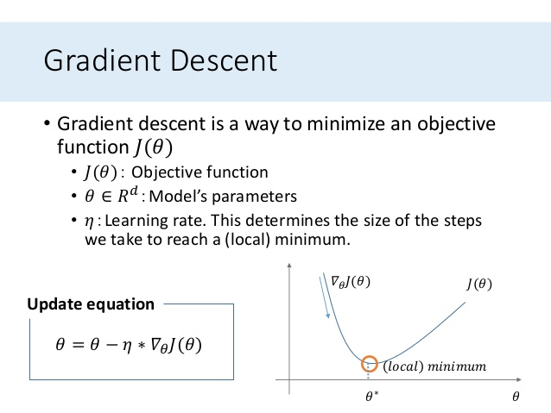
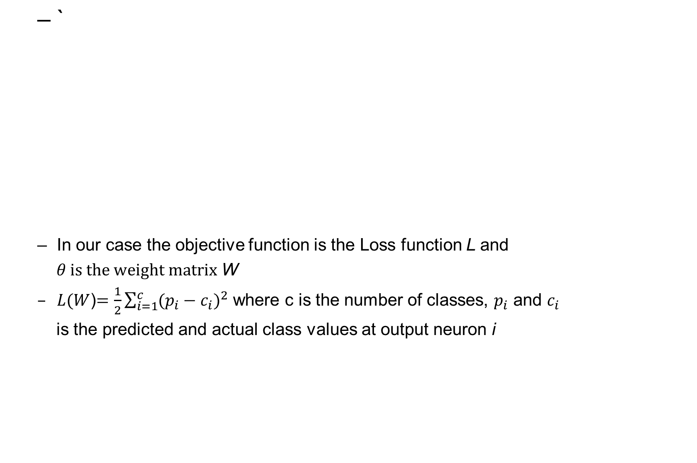
Gradient Descent learning

Slide 37
Backpropagation Algorithm for learning ANN
Initialize the weights (w₀, w₁, …, w_{k}) randomly
Compute the error at each output node (k), and the hidden node (j) connected to it.
Now adjust the weights w_{jk} such that
w_{jk}(new) = w_{jk}(current)-Δw_{jk}
where Δw_{jk}=rError(k)O_{j}
r = learning rate parameter (0<r<1)
Error(k) = the computed error at node k
O = output of node j

Slide 38
Appendix (optional readings)
The following slides are for interest only, they will not be used for examination purposes

Slide 39

Weight derivation using Backpropagation (to come later this week)

Slide 40
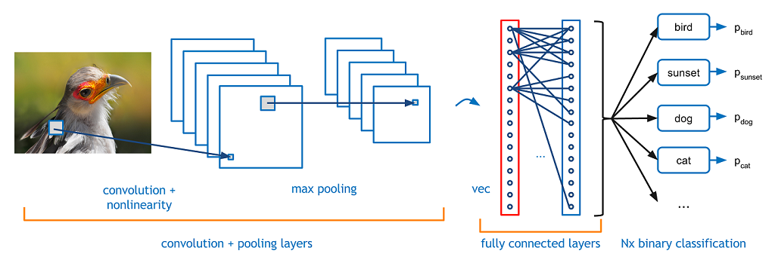
Convolutional Neural Nets

Slide 41
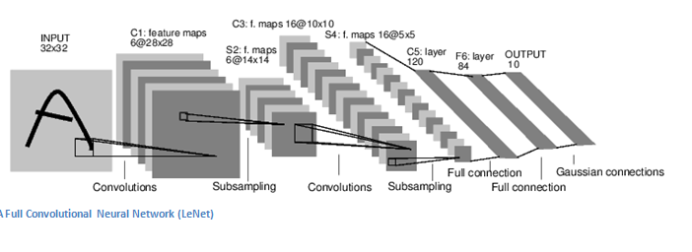
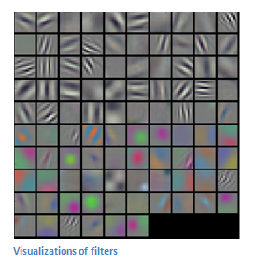
Convolutional Neural Nets

Slide 42
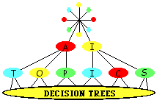
Decision Trees
Positive and negative examples
Attribute split
Entropy measures

Slide 43
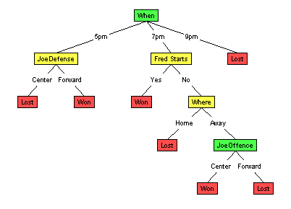
Where | When | Fred Starts | Joe offense | Joe defends | Opp C | OutCome
Home | 7pm | Yes | Center | Forward | Tall | Won
Home | 7pm | Yes | Forward | Center | Short | Won
Away | 7pm | Yes | Forward | Forward | Tall | Won
Away | 9pm | Yes | Forward | Forward | Short | Lost
Home | 7pm | Yes | Center | Center | Tall | Won
Away | 7pm | Yes | Center | Center | Short | Won
Away | 9pm | Yes | Center | Forward | Short | Lost
Home | 7pm | Yes | Center | Center | Short | Won
Home | 7pm | Yes | Center | Forward | Short | Won
Home | 7pm | Yes | Center | Forward | Tall | Won
There are about 20 more records

Slide 44
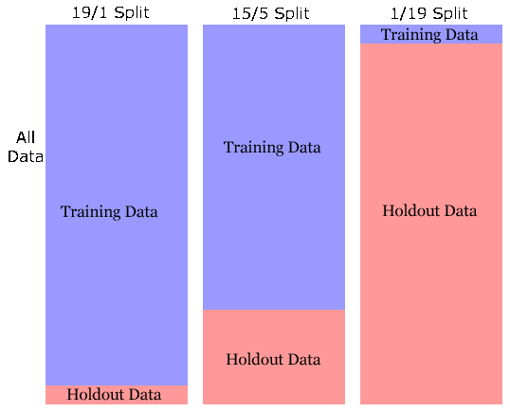
Data split for supervised learning

Slide 45
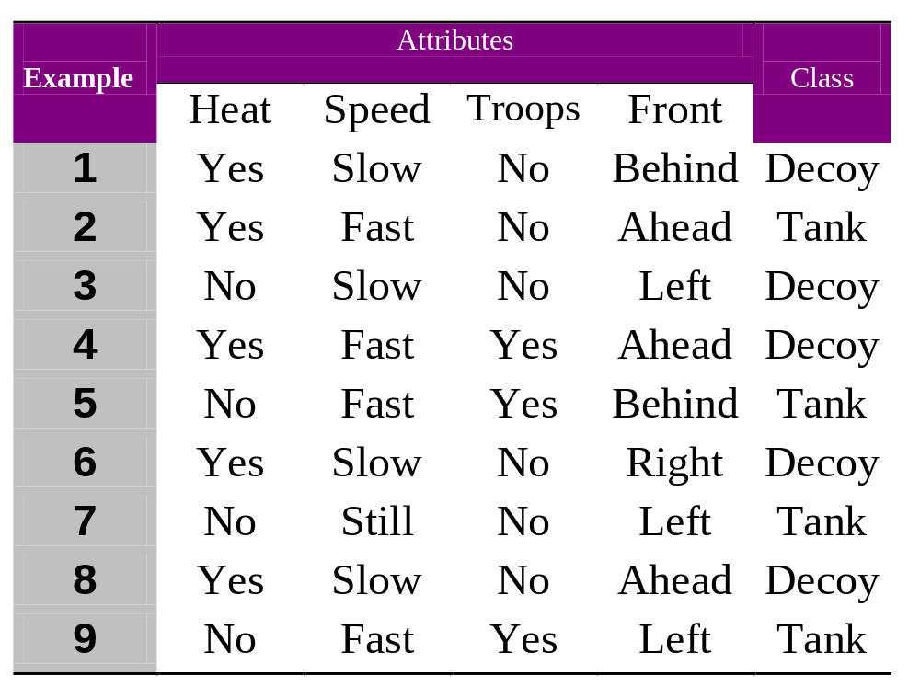
Positive and Negative Examples

Slide 46
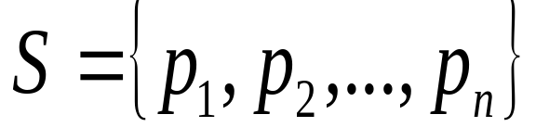
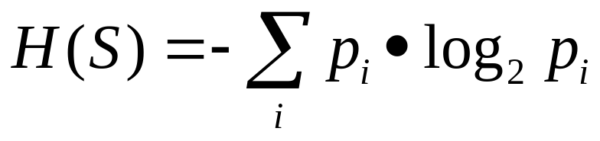
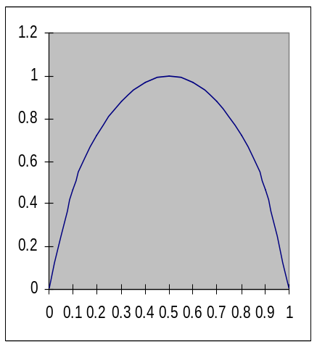
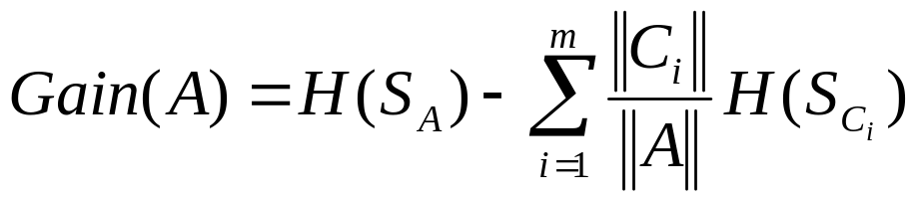

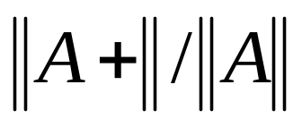
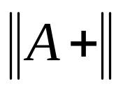
Entropy
H(p,1-p)
= no. training samples at A
A
= <p_{A},1-p_{A}>
p_{A} =
C₁
C₂
...
C_{m}
= no. positive training
samples at A

Slide 47
Split Based on Attribute “Speed”
Speed
+: 1, 3, 4, 6, 8
-: 2, 5, 7, 9
Still
Fast
Slow
+:
+: 1, 3, 6, 8
+: 4
-: 7
-:
-: 2, 5, 9
Gain(Speed) = H(5/9,4/9) - 1/9H(0,1)-4/9H(1,0)-4/9H(1/4,3/4)
= 0.63

Slide 48
Split Based on Attribute “Front”
Front
+: 1, 3, 4, 6, 8
-: 2, 5, 7, 9
Behind
Left
Right
Ahead
+: 1
+: 6
+: 4, 8
+: 3
-: 5
-:
-: 2
-: 7, 9
Gain(Front) = H(5/9,4/9) - 2/9H(1/2,1/2)-1/9H(1,0)
-3/9H(2/3,1/3)-3/9H(1/3,2/3) = 0.16

Slide 49
Split on “Speed” then “Heat”
Speed
+: 1, 3, 4, 6, 8
-: 2, 5, 7, 9
Still
Fast
Slow
Heat
+: 4
-: 2, 5, 9
+:
+: 1, 3, 6, 8
Yes
No
-: 7
-:
Gain(Heat) = What?
H(1/4,3/4)-2/4H(1/2,1/2)-2/4H(0,1)
= 0.31
+: 4
+:
-: 2
-: 5, 9

